Slide 1
Vehicle Tracking
Initial Exploration

Slide 2
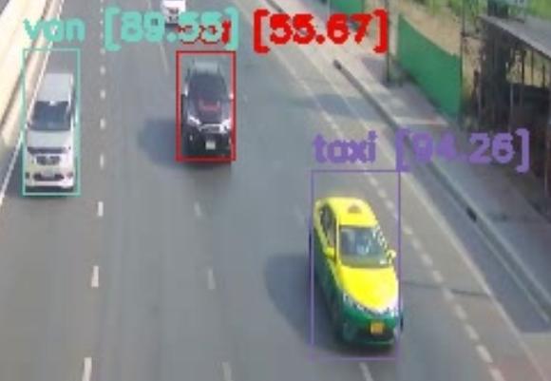
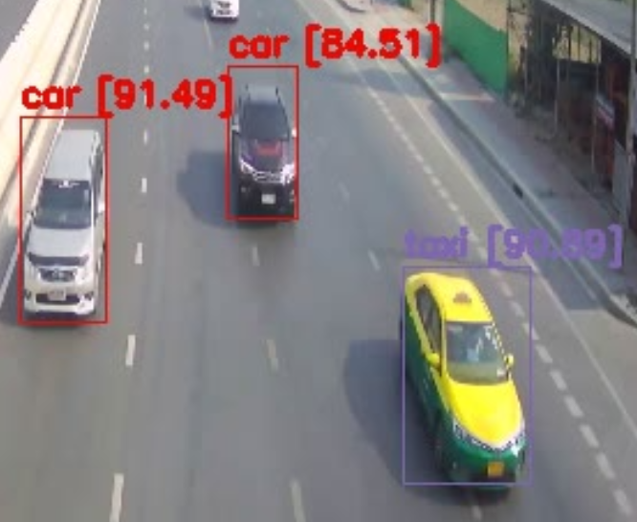
Detection: YOLO v4 (Current progress)

Slide 3
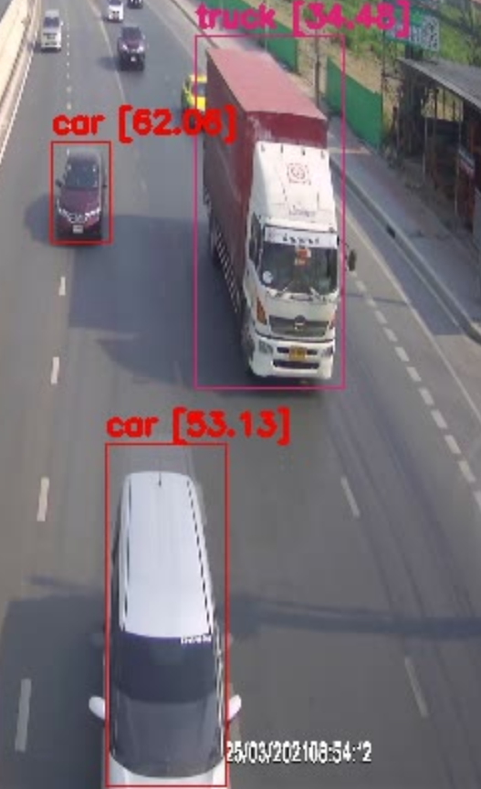

Slide 4
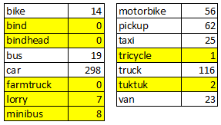
Model: Need Improvement
More clean data
Scaled Yolo v4
Try other model

Slide 5
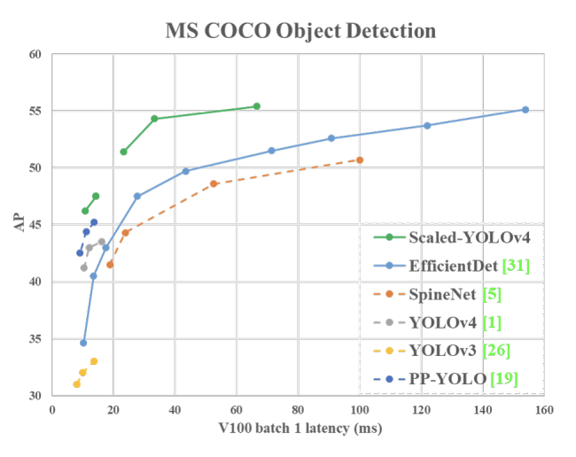

Slide 6
Tracking: Norfair (Euclidean distance: 30)

Slide 7
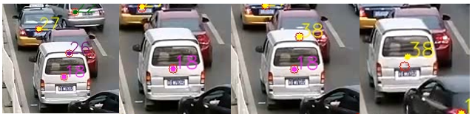
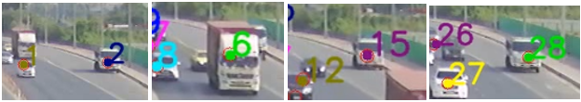
Norfair: Confusion on Overlapping image

Slide 8
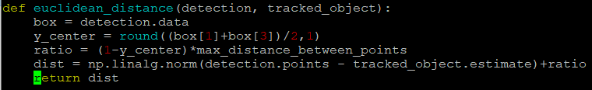
Norfair: Custom distance function
Base on: Euclidean
Perspective adjustment
Ratio adjustment
on Y axis

Slide 9
Norfair: Tracker parameters
distance_function
distance_threshold
hit_inertia_min (optional)
hit_inertia_max (optional)
initialization_delay (optional)
detection_threshold (optional)
point_transience (optional)

Slide 10
Case Study: Yolov4 - Traffic control in Taiwan

